Slide 1
November 2022
Ford Fund
Capital Grants Program
Working directly with communities to design and fund programs for communities.

Slide 2
01
Program Requirements
Table of contents
02
Submission Requirements
03
Submission Process
04
Application Review
05
Grantmaking Timeline and Process
06
Q & A

Slide 3
Program Requirements
West Tennessee Capital Grants Program will award funding requests that fall under one of three different types of support:
Social Mobility, examples could include:
Food Banks
Economic Mobility, examples could include:
Job Training Centers
Makerspaces
General Community Betterment, examples could include:
Playgrounds
Community Centers
Notes:
For the purposes of this program, the Ford Fund defines capital as a physical infrastructure, construction of new and/or renovated space, and related equipment purchases. We will not consider endowment funding as a part of this program. Vehicle purchases will also not be considered.

Slide 4
Program Requirements
Grants to be awarded to an organization will range from $25,000 - $100,000. Multiple-year commitments will not be made at this time.
The Capital Grant Program is only open to U.S. based 501c3 Nonprofit organizations, municipalities, and non-tax-exempt organizations doing work in the following areas in West Tennessee: Haywood County, Fayette County, Tipton County, Lauderdale County, Shelby County and Madison County. If your organization is a municipality or not tax-exempt, United Way of West Tennessee can assist with the application process.

Slide 5
Submission Requirements
A brief description of the overall project, including the requested Capital funding amount.
A description of the specific project Ford Motor Company Fund capital funding will support, including a basic budget.
Any naming opportunities.
A description of related programs that could be linked to this capital grant in future years.
If your organization is selected to receive a Capital Grant, you will be required to submit a final grant report at the end of your grant cycle.

Slide 6
Submission Process
All grant proposals must be submitted through our online grant system.
United Way of West Tennessee will serve as a fiscal sponsor for municipalities and non-tax-exempt organizations.
To access our grant system, go to: https://unitedwayofwesttennessee.submittable.com/submit/1c27d9f7-30b2-480a-9976-7ca2dc0837dd/west-tennessee-capital-grant-program
Create an account. Once you are approved and logged in select "West Tennessee Capital Grant Program" from the available options.

Slide 7
Submission Process
Follow the onscreen instructions and input your grant submission. Hit the "Submit Form" button to send your proposal.
You will receive an automated confirmation e-mail once your proposal has been successfully submitted.
Proposals must be submitted according to the instructions outlined above. Any proposals submitted outside of the process will not be considered for funding.

Slide 8
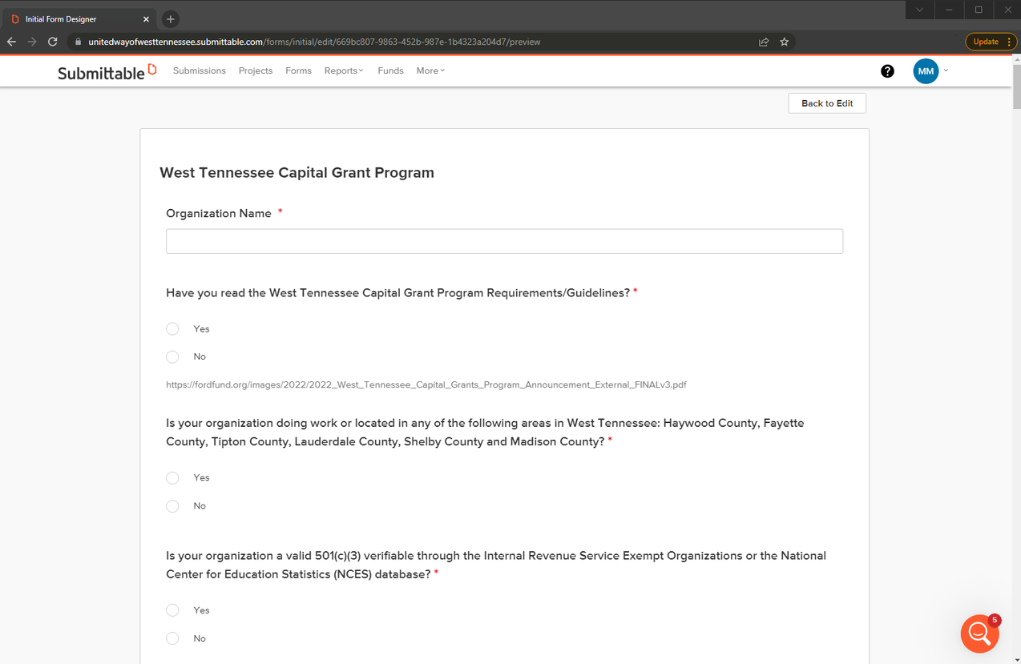
Application Review
Notes:
https://unitedwayofwesttennessee.submittable.com/submit/1c27d9f7-30b2-480a-9976-7ca2dc0837dd/west-tennessee-capital-grant-program

Slide 9
Grantmaking Timeline and Process
The Grant Portal is Open Today.
Applications are due in our online system by 11:59 p.m. CST on Tuesday, January 3, 2023.
Applicants will be notified of the results by April 3, 2023.

Slide 10
November 2022
Q & A
Working directly with communities to design and fund programs for communities.

Slide 11
Contact us
November 2022
470 N Parkway
Jackson, TN 38305
Working directly with communities to design and fund programs for communities.
731-422-1816
give@unitedway.tn.org

Slide 12
Thank you
for your interest

